Slide 1

Applying the Shuffle Model of Differential Privacy to Vector Aggregation
Mary Scott, Graham Cormode, Carsten Maple
BICOD21, Monday 28th March 2022, Imperial College London
Notes:
Good afternoon. My name is Mary Scott, I am a PhD student at University of Warwick, and I will be giving a presentation of our paper “Applying the Shuffle Model of Differential Privacy to Vector Aggregation”. This is joint work with my supervisors Graham Cormode and Carsten Maple. I would have liked to join you all at Imperial College today, but unfortunately, I currently have Covid which means I must present online. \\

Slide 2
Research Motivation
Research Area: privacy-enhancing technologies (PETs), with particular focus on differential privacy (DP):
Strong, mathematical definition of privacy in context of statistical and machine learning (ML) analysis.
Guarantees measurable level of confidentiality for any data subject in dataset to which it is applied.
Impact on any individual as result of analysis on dataset is the same, whether said individual is included in the dataset.
Notes:
First, I want to give a bit of background about the topic of our paper. \\ Throughout my PhD, I have been investigating privacy-enhancing technologies, with a specific focus on differential privacy. \\ Differential privacy is a definition which gives a mathematical guarantee for a particular level of privacy, and is stronger and more precise than other methods of protecting the privacy of users. \\ Having differential privacy means that it doesn’t matter whether the data of one individual is in a dataset or not, we can remove it and the overall conclusion of the analysis on this dataset will not be changed too much. \\

Slide 3
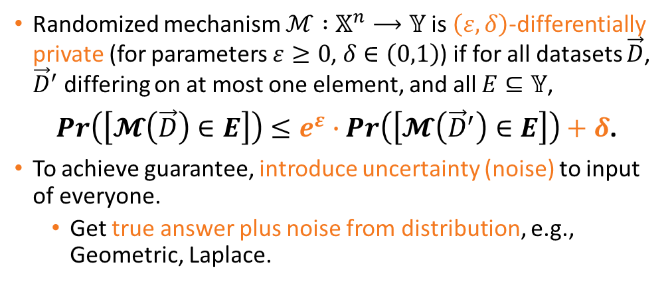
Research Motivation
Randomized mechanism $ℳ :𝕏^{n}⟶𝕐$ is $\left(ε,δ\right)$-differentially private (for parameters $ε≥0$, $δ∈\left(0,1\right)$) if for all datasets $\vec{D}$, ${\vec{D}}^{′}$ differing on at most one element, and all $E⊆𝕐$,
$Pr\left(\left[𝓜\left(\vec{D}\right)∈E\right]\right)≤e^{ε}∙$ $Pr\left(\left[𝓜\left({\vec{D}}^{′}\right)∈E\right]\right)+δ$.
To achieve guarantee, introduce uncertainty (noise) to input of everyone.
Get true answer plus noise from distribution, e.g., Geometric, Laplace.
Notes:
\\ Mathematically, a randomized mechanism M is differentially private, if there is essentially equal probability of M filling the same output space, when applied to dataset D, compared to the dataset D prime, with at most one individual added or removed. \\ The multiplicative parameter e to the epsilon, used to make composition more convenient, and the additive parameter delta are both small, but represent the level of noise that must be added to all users for the differential privacy guarantee to be fulfilled. This noise is typically derived from a distribution such as Geometric or Laplace, and is carefully calculated to mask the raw data from difference attacks while maintaining good utility. \\

Slide 4
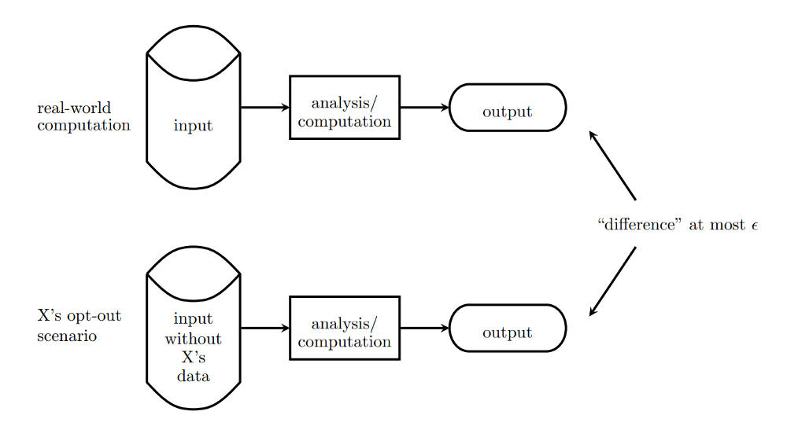
Notes:
This diagram emphasises the content of the previous slide, that we take our two inputs, the original and the small change in the data of one individual, run identical analysis on both, and then compare the outputs to see if the “difference” is within our epsilon or not. \\

Slide 5
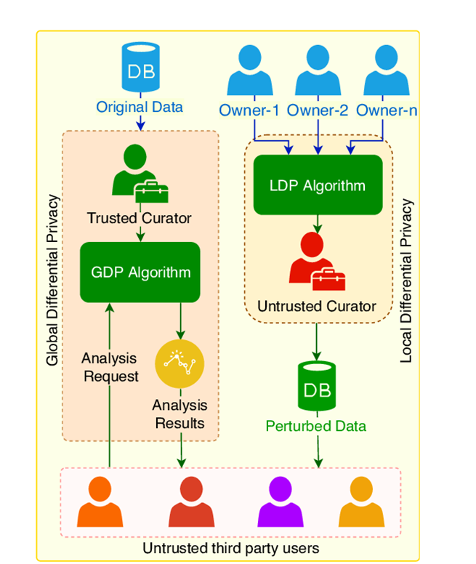
Models of Differential Privacy
Centralized Model of DP: random noise only introduced after users’ outputs are gathered by trusted aggregator, who
obtains raw data from all users,
and introduces necessary perturbations.
Local Model of DP: each user independently applies local randomizer on their input to obtain perturbed result.
Notes:
Now we move on to the different methods, or models, that can be used to achieve a differential privacy guarantee. \\ The first, and most popular, method is for a central entity to collect all the raw data from all the users, and to calculate and add the necessary noise to the aggregated data. \\ A contrasting method is the Local Model, where each user independently adds their own noise to their raw data. \\

Slide 6
Models of Differential Privacy
Local Model of DP: no need for trusted party but noise required (per user) for same privacy guarantee is much higher.
Limits usage to major companies, e.g., Google, Apple, Microsoft.
Neither model provides a good balance between trust of central entity and level of noise required to guarantee DP.
Notes:
\\ One good reason to adopt the Local Model is so that the central entity doesn’t get to see the raw data before it has been perturbed. In this way, there is no need for a trusted party, however for this greater level of privacy we require more noise per user. So it means that the Local Model is limited to being used by companies with a large processing power-to-user ratio, i.e. Google, Apple and Microsoft. \\ We can see that each of the two models has its own advantages, but neither is successful at both trust and level of noise. \\

Slide 7

Shuffle Model of DP
(Single-Message) Shuffle Model sits between Centralized and Local Models of DP:
Noise required per user for same privacy guarantee is not as high as in Local Model.
Adds “shuffling step” to Local Model:
After data from each user is encoded, it is randomly permuted to unbind each user from their data before analysis takes place.
Notes:
\\ To achieve a middle ground between the Centralized and Local Models, the Shuffle Model has been adopted. \\ The Shuffle Model is an adaptation of the Local Model, with the randomization step exactly the same, but afterwards a “shuffler” is added to perform a random permutation of the data. The level of noise required for the same privacy guarantee is reduced, by making it impossible for the central entity or an adversary to tell which data belongs to which user. \\

Slide 8
Shuffle Model of DP
Introduced in 2019 (much more work to be done).
Contrasts with general DP (first defined in 2006).
Scott et al., BICOD21: formalize protocol for vector-valued summation, extending existing protocol only applicable for scalars.
Notes:
\\ As the Shuffle Model has been introduced relatively recently, compared to the Centralized Model which has been around for over fifteen years, there is much more scope for new research to be developed on it. \\ Therefore, this is why we have chosen to write a protocol for the summation of vector-valued messages, specifically in this model, which builds on a previous protocol for scalars. \\

Slide 9
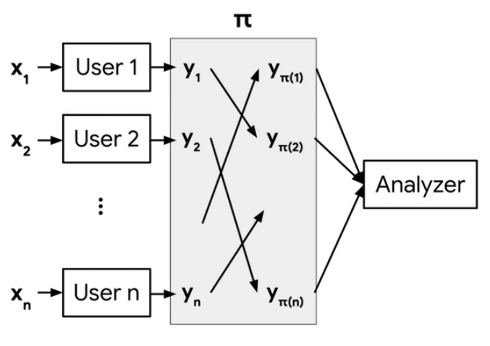
Notes:
We can see the different steps of the Shuffle Model in this diagram, including the local randomization step from each x_i to y_i, and the shuffling step, or permutation pi, which unbinds each of the y_i’s from the user that it originated from. \\

Slide 10
Extending the Shuffle Model to Vectors
Extend “The Privacy Blanket of the Shuffle Model” (Balle et al., 2019) to be applicable to vectors rather than just scalars.
Contribution: protocol in Single-Message Shuffle Model for private summation of vector-valued messages (Scott et al., BICOD21)
Can be extended to produce similar protocol for linearization of matrices and higher-dimensional tensors,
useful for representation of multi-dimensional data in Neural Networks.
Notes:
\\ \\ The main result of our paper is a new protocol in the Single-Message Shuffle Model, the Shuffle Model where each user sends a single message, for the private summation of vector-valued messages. \\ This result can be extended to produce similar protocols in higher dimensions, useful for applications such as the representation of multi-dimensional data in Neural Networks, for example. \\

Slide 11
Applications for Vector Data Collection
Why choose vectors specifically as data type?
Practical applications in Federated Learning,
where multiple users collaboratively solve ML problem,
e.g., training Deep Neural Network (DNN) to predict next word that user types,
with updates in high-dimensional vector form generated by users after each round.
Notes:
More applications can be found for our protocol if we consider each of the decisions we made. \\ Why in particular did we choose to investigate vectors? \\ Well, in Federated Learning, where we have many users collaborating on a machine learning problem, for the purpose of word prediction for example, the updates are in high-dimensional vector form. So we have a good application for this type of data. \\

Slide 12
Applications for Vector Data Collection
Why investigate aggregation of vectors?
Closely related to Secure Aggregation:
used to compute outputs of ML problems such as the example above.
Requires only element-wise weighted averages of update vectors.
Notes:
\\ As well as vectors, why choose aggregation? \\ \\ Well, we have a link to secure aggregation, useful in the machine learning problems we have already seen, but more importantly the update vectors are in a good form to make this calculation simple. And also, after aggregation it’s easy to calculate the mean, variance etc., which is good for any kind of statistical application. \\

Slide 13
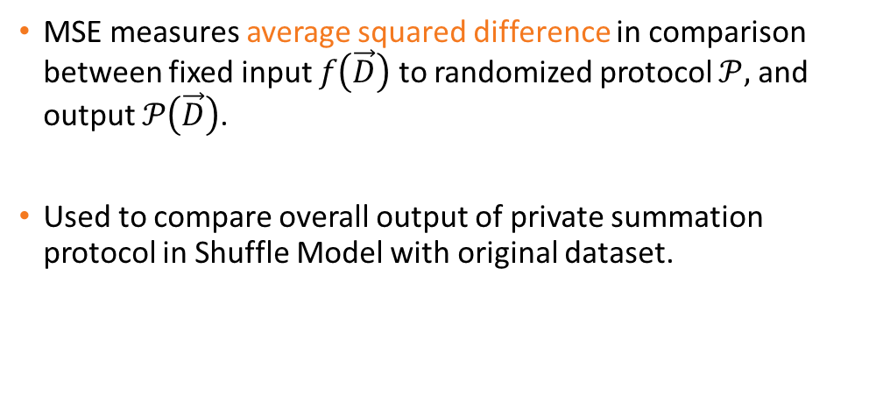
Accuracy Measure: Mean Squared Error (MSE)
MSE measures average squared difference in comparison between fixed input $f\left(\vec{D}\right)$ to randomized protocol $𝒫,$ and output $𝒫\left(\vec{D}\right)$.
Used to compare overall output of private summation protocol in Shuffle Model with original dataset.
Notes:
Now let’s look at the accuracy measure of our analysis: the mean squared error. \\ \\ We use this calculation to compare the input of our protocol with the overall output, so before and after adding the privacy, doing the shuffling step, and also the aggregation at the end. \\

Slide 14
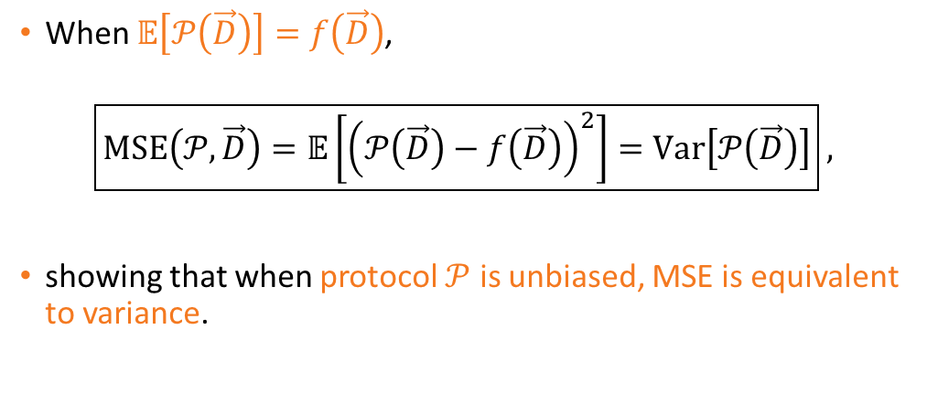
Accuracy Measure: Mean Squared Error (MSE)
When $𝔼\left[𝒫\left(\vec{D}\right)\right]=f\left(\vec{D}\right)$,
$$\boxed{MSE\left(𝒫,\vec{D}\right)=𝔼\left[{\left(𝒫\left(\vec{D}\right)−f\left(\vec{D}\right)\right)}^{2}\right]=Var\left[𝒫\left(\vec{D}\right)\right]} ,$$
showing that when protocol $𝒫$ is unbiased, MSE is equivalent to variance.
Notes:
\\ \\ A useful mathematical property of the mean squared error is that when our protocol is unbiased, it is equivalent to the variance, which makes our calculations easy. \\

Slide 15
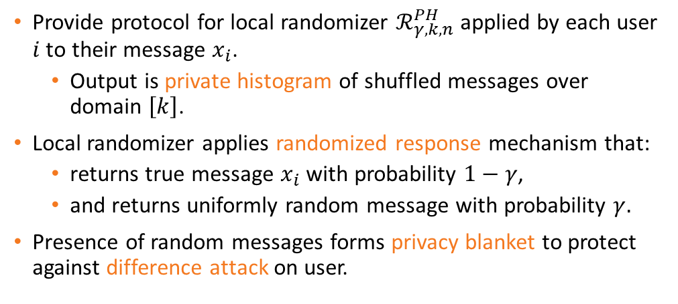
Protocol for Local Randomizer
Provide protocol for local randomizer $ℛ_{γ,k,n}^{PH}$ applied by each user $i$ to their message $x_{i}$.
Output is private histogram of shuffled messages over domain $\left[k\right]$.
Local randomizer applies randomized response mechanism that:
returns true message $x_{i}$ with probability $1−γ$,
and returns uniformly random message with probability $γ.$
Presence of random messages forms privacy blanket to protect against difference attack on user.
Notes:
\\ The simplest protocol we created was a general one for the local randomizer which each user applies to their message, resulting in a private histogram. \\ The main mechanism in the protocol is the randomized response, which in most cases returns the true message, and with a small probability gamma chooses a uniformly random message instead. \\ This small number of random messages is sufficient to protect against a difference attack on any user. \\

Slide 16
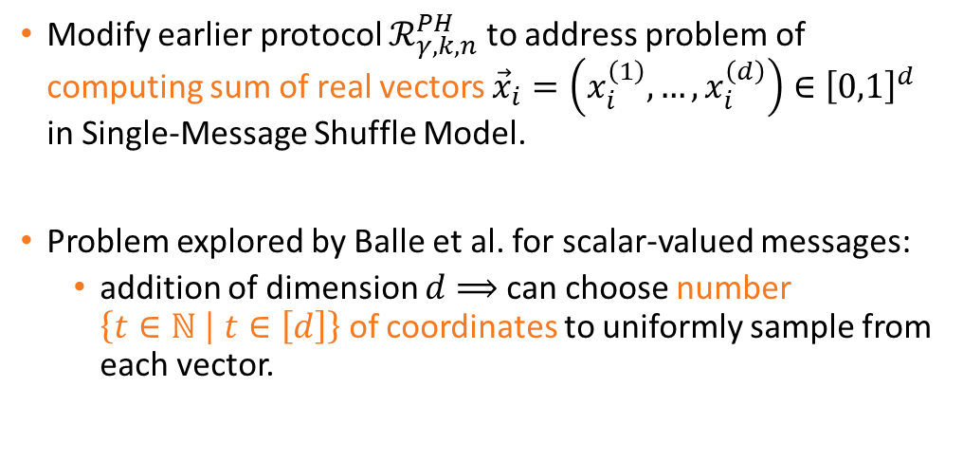
Modified Protocol for Local Randomizer
Modify earlier protocol $ℛ_{γ,k,n}^{PH}$ to address problem of computing sum of real vectors ${\vec{x}}_{i}=\left(x_{i}^{\left(1\right)},…,x_{i}^{\left(d\right)}\right)∈{\left[0,1\right]}^{d}$ in Single-Message Shuffle Model.
Problem explored by Balle et al. for scalar-valued messages:
addition of dimension $d⟹$ can choose number $\left\{t∈ℕ \left| t∈\left[d\right]\right.\right\}$ of coordinates to uniformly sample from each vector.
Notes:
\\ The general protocol for the local randomizer can be modified to specifically address our problem of summing real vectors in the Shuffle Model. \\ By expanding on the previous paper from Balle et al. to consider vector-valued messages, we have an additional dimension d to sample any number t from one to all coordinates from each vector. \\

Slide 17
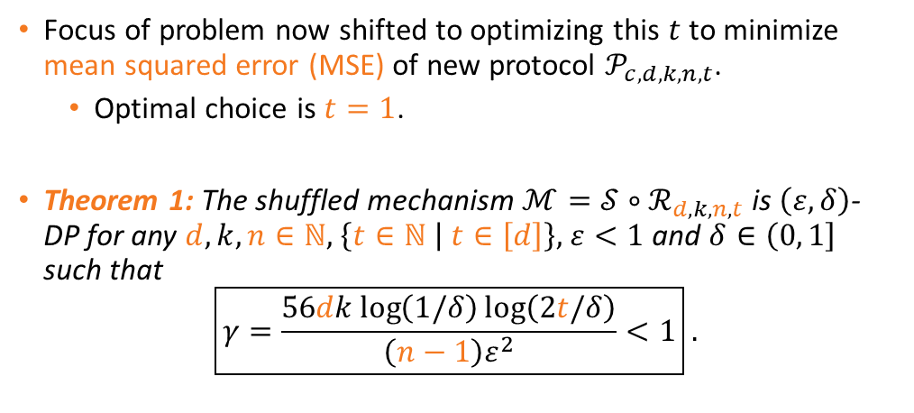
Privacy Analysis of Modified Protocol
Focus of problem now shifted to optimizing this $t$ to minimize mean squared error (MSE) of new protocol $𝒫_{c,d,k,n,t}$.
Optimal choice is $t=1$.
Theorem 1: The shuffled mechanism $ℳ=𝒮∘ℛ_{d,k,n,t}$ is $\left(ε,δ\right)$-DP for any $d,k,n∈ℕ,$ $\left\{t∈ℕ \left| t∈\left[d\right]\right.\right\},$ $ε<1$ and $δ∈\left(0,\left.1\right]\right.$ such that
$$\boxed{γ=\frac{56dk\log\left(1/δ\right)\log\left(2t/δ\right)}{\left(n−1\right)ε^{2}}<1} .$$
Notes:
\\ In this way, the focus of our problem has now shifted to optimizing this t to minimize the mean squared error. \\ The optimal choice is to sample just the one coordinate, and this is backed up by our first theorem, which gives the value of gamma, the parameter of the randomized response, which fulfils our differential privacy guarantee given the constraints of the other parameters. \\

Slide 18
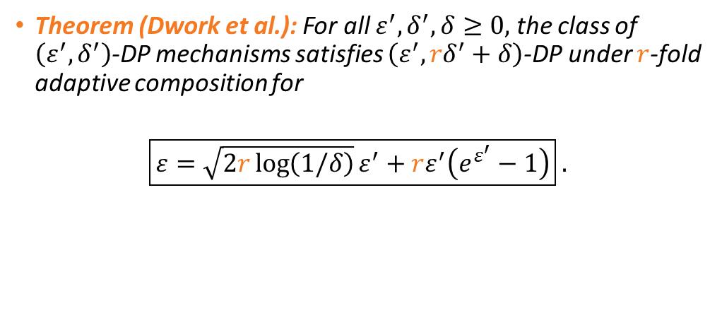
Advanced Composition Results Used
Theorem (Dwork et al.): For all $ε^{′},δ^{′},δ≥0,$ the class of $\left(ε^{′},δ^{′}\right)$-DP mechanisms satisfies $\left(ε^{′},{rδ}^{′}+δ\right)$-DP under $r$-fold adaptive composition for
$$\boxed{ε=\sqrt{2r\log\left(1/δ\right)}ε^{′}+rε^{′}\left(e^{ε^{′}}−1\right)} .$$
Notes:
These “advanced composition” results are used to compute the differential privacy parameters for vectors rather than scalars. \\ The epsilon prime and delta prime are used in the differential privacy definition for one coordinate of a vector, and if we have r of these coordinates in the general case, we can show that the parameter epsilon of the composite differential privacy of the entire vector is of this form. This expression is hard to use, mainly because of the complex second term involving epsilon prime multiplied by e to the epsilon prime. \\

Slide 19
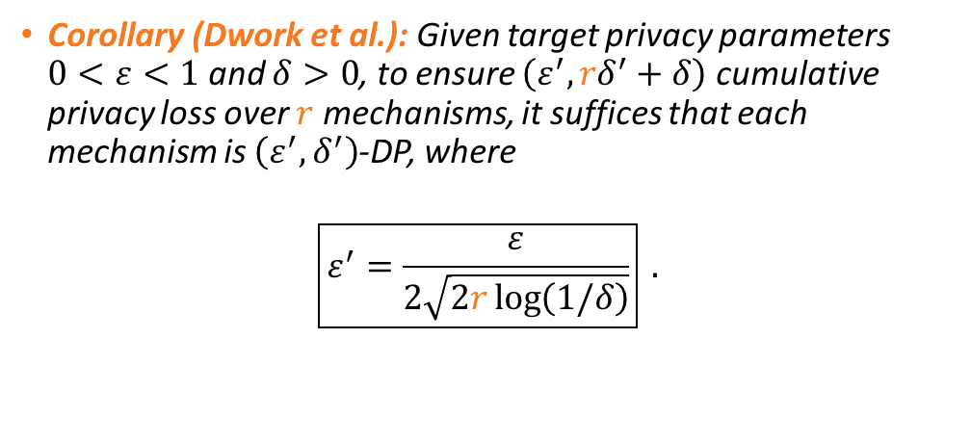
Advanced Composition Results Used
Corollary (Dwork et al.): Given target privacy parameters $0<ε<1$ and $δ>0$, to ensure $\left(ε^{′},{rδ}^{′}+δ\right)$ cumulative privacy loss over $r$ mechanisms, it suffices that each mechanism is $\left(ε^{′},δ^{′}\right)$-DP, where
$$\boxed{ε^{′}=\frac{ε}{2\sqrt{2r\log\left(1/δ\right)}}} .$$
Notes:
\\ This corollary provides a simpler expression, which may not be as precise as the one in the previous theorem, but is much more usable while remaining sufficient to satisfy the differential privacy requirement. It is also expressed the other way around, with the epsilon prime for the privacy of each coordinate expressed in terms of the epsilon for the privacy of the entire vector, making it more useful for computing the error for each coordinate at a time. \\

Slide 20
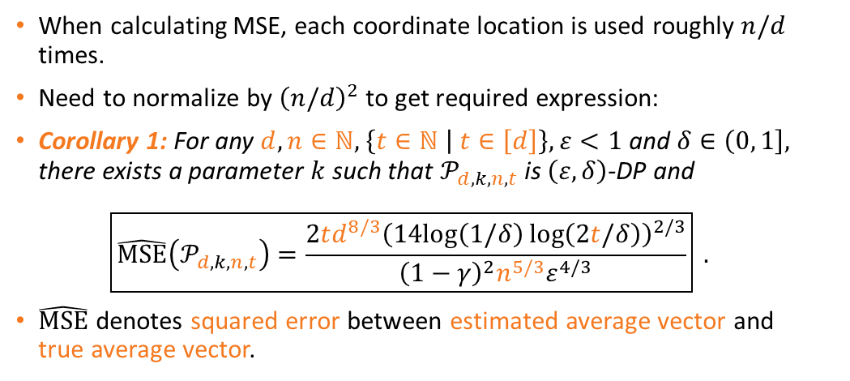
Normalizing Mean Squared Error (MSE)
When calculating MSE, each coordinate location is used roughly $n/d$ times.
Need to normalize by ${\left(n/d\right)}^{2}$ to get required expression:
Corollary 1: For any $d,n∈ℕ,$ $\left\{t∈ℕ \left| t∈\left[d\right]\right.\right\},$ $ε<1$ and $δ∈\left(0,\left.1\right]\right.,$ there exists a parameter $k$ such that $𝒫_{d,k,n,t}$ is $\left(ε,δ\right)$-DP and
$$\boxed{\hat{MSE}\left(𝒫_{d,k,n,t}\right)=\frac{2td^{8/3}{\left(14log\left(1/δ\right)\log\left(2t/δ\right)\right)}^{2/3}}{{\left(1−γ\right)}^{2}n^{5/3}ε^{4/3}}} .$$
$\hat{MSE}$ denotes squared error between estimated average vector and true average vector.
Notes:
\\ The next step is to calculate the mean squared error. \\ But this error needs to be normalized because in the randomized response step, each coordinate location is used roughly n over d times. \\ \\ The corollary displays the relationships between the normalized mean squared error and the number of coordinates t, the vector dimension d and the number of vectors n. \\

Slide 21
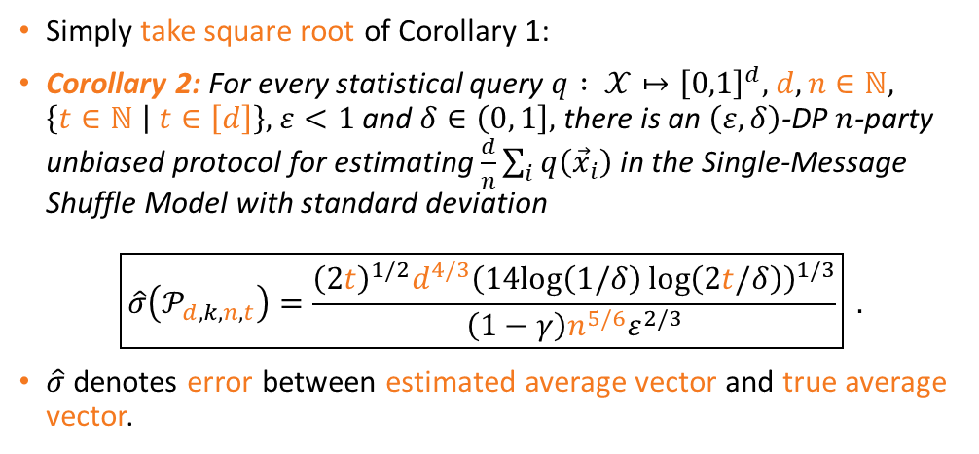
Useful Error: Between Average Vectors
Simply take square root of Corollary 1:
Corollary 2: For every statistical query $q : 𝒳↦{\left[0,1\right]}^{d},$ $d,n∈ℕ,$ $\left\{t∈ℕ \left| t∈\left[d\right]\right.\right\},$ $ε<1$ and $δ∈\left(0,\left.1\right]\right.,$ there is an $\left(ε,δ\right)$-DP $n$-party unbiased protocol for estimating $\frac{d}{n}\sum_{i}{q\left({\vec{x}}_{i}\right)}$ in the Single-Message Shuffle Model with standard deviation
$$\boxed{\hat{σ}\left(𝒫_{d,k,n,t}\right)=\frac{{\left(2t\right)}^{1/2}d^{4/3}{\left(14log\left(1/δ\right)\log\left(2t/δ\right)\right)}^{1/3}}{\left(1−γ\right)n^{5/6}ε^{2/3}}} .$$
$\hat{σ}$denotes error between estimated average vector and true average vector.
Notes:
\\ A more useful error can be found by taking the square root of the previous corollary. \\ \\ The normalized standard deviation sigma hat is used as the standard measure of privacy in the comparison between different papers, but because this is the first result for vector-valued messages, it is not appropriate to give direct comparisons at this time. \\

Slide 22
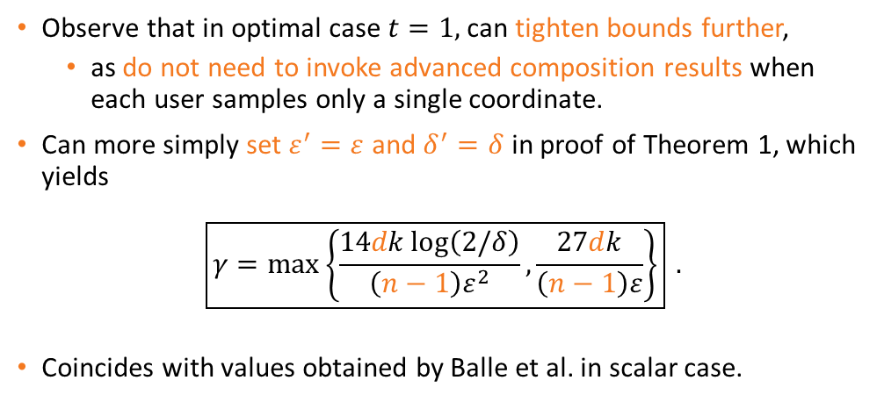

Improved Bounds for $t=1$
Observe that in optimal case $t=1,$ can tighten bounds further,
as do not need to invoke advanced composition results when each user samples only a single coordinate.
Can more simply set $ε^{′}=ε$ and $δ^{′}=δ$ in proof of Theorem 1, which yields
$$\boxed{γ=max\left\{\frac{14dk\log\left(2/δ\right)}{\left(n−1\right)ε^{2}},\frac{27dk}{\left(n−1\right)ε}\right\}} .$$
Coincides with values obtained by Balle et al. in scalar case.
Notes:
\\ It is possible to tighten the previous bounds further by assuming the optimal result t equals 1. \\ We can abandon the complex advanced composition results to more simply set epsilon prime equals epsilon and delta prime equals delta in the proof of our expression of gamma, to get the result shown on the screen. \\ As expected, this coincides with the expression in the previous work, since in effect t equals 1 in the scalar case as well. \\

Slide 23
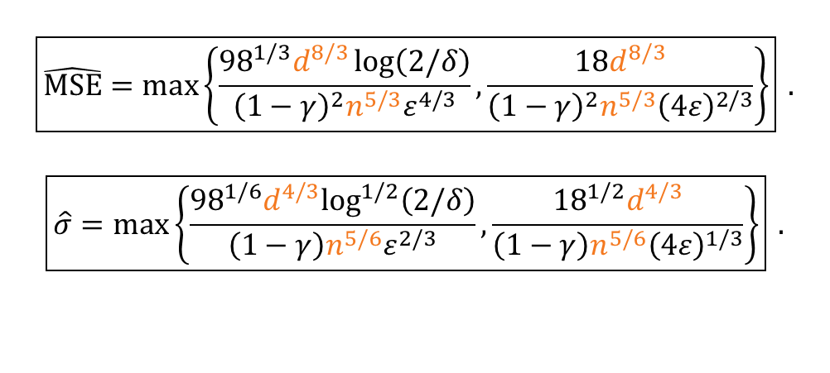
Improved Bounds for $t=1$
$$\boxed{\hat{MSE}=max\left\{\frac{{98}^{1/3}d^{8/3}\log\left(2/δ\right)}{{\left(1−γ\right)}^{2}n^{5/3}ε^{4/3}},\frac{18d^{8/3}}{{\left(1−γ\right)}^{2}n^{5/3}{\left(4ε\right)}^{2/3}}\right\}} .$$
$$\boxed{\hat{σ}=max\left\{\frac{{98}^{1/6}d^{4/3}\log^{1/2}\left(2/δ\right)}{\left(1−γ\right)n^{5/6}ε^{2/3}},\frac{{18}^{1/2}d^{4/3}}{\left(1−γ\right)n^{5/6}{\left(4ε\right)}^{1/3}}\right\}} .$$
Notes:
\\ \\ And when we carry this simpler expression for gamma forward, we obtain the following expressions for the normalized mean squared error and standard deviation. \\

Slide 24
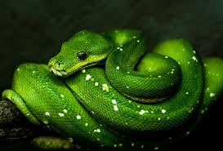
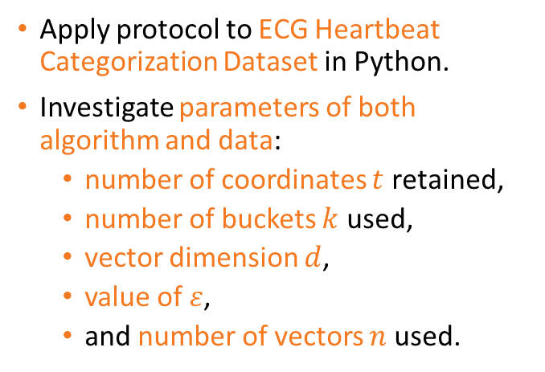
Experimental Evaluation
Apply protocol to ECG Heartbeat Categorization Dataset in Python.
Investigate parameters of both algorithm and data:
number of coordinates $t$ retained,
number of buckets $k$ used,
vector dimension $d$,
value of $ε$,
and number of vectors $n$ used.
Notes:
\\ In our experimental study, we use a real dataset of heartbeat signals in an implementation of our protocol that we wrote in Python. \\ We investigate parameters of both the algorithm and the data, including the number of coordinates t, the number of buckets k used in the randomized response, the vector dimension d, the value of epsilon, and the number of vectors used. \\

Slide 25
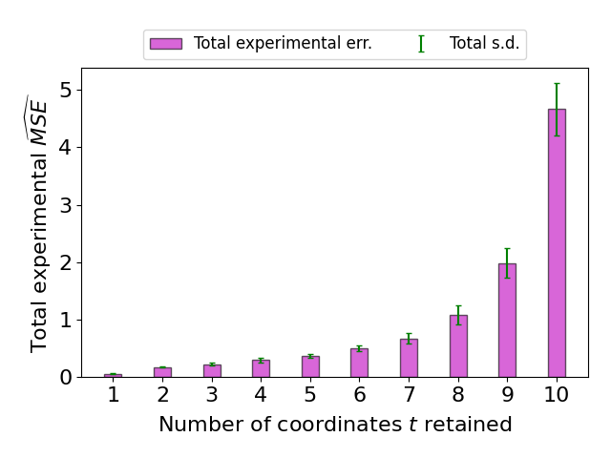
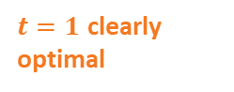
$t=1$ clearly optimal
Notes:
We have already established theoretically that the smaller t is, the smaller the normalized mean squared error is, but looking at the experimental results of sampling between one and ten coordinates really emphasises the fact that t equals 1 is the optimal choice. \\

Slide 26
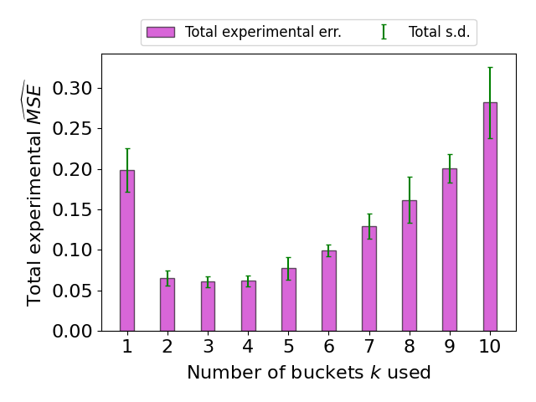
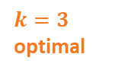
$k=3$ optimal
Notes:
In the same way, we can see that k equals 3 is the optimal choice for our randomized response algorithm, although this conclusion is not quite as clear-cut. \\

Slide 27
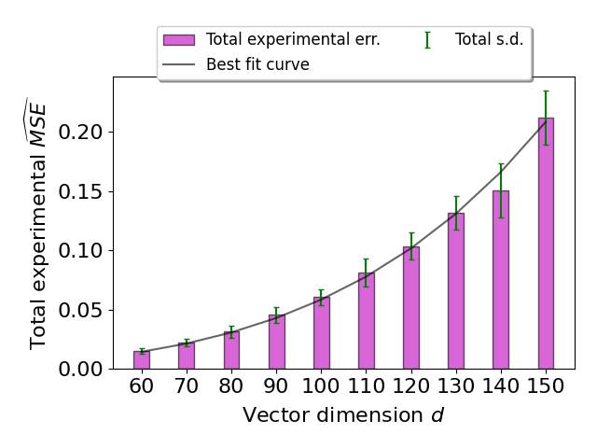
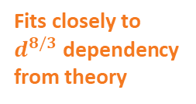
Fits closely to $d^{8/3}$ dependency from theory
Notes:
In this graph a best fit curve dependent on d to the eight thirds is plotted, which closely fits to the data, thus matching the expected dependency on d from Corollary 1. \\

Slide 28
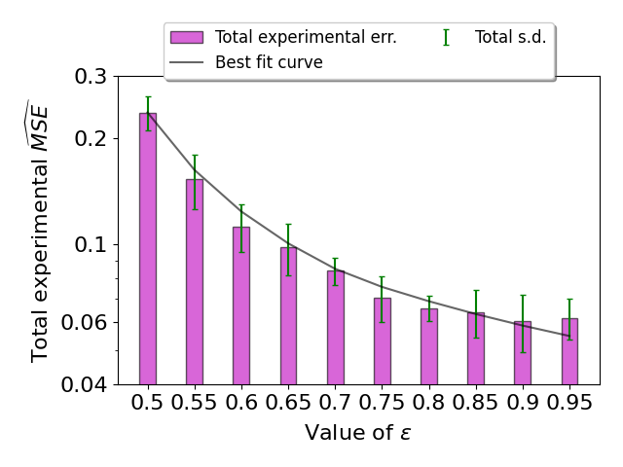
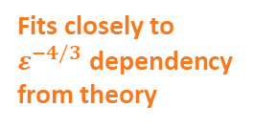
Fits closely to $ε^{−4/3}$ dependency from theory
Notes:
Similar curves can be plotted for small epsilon… \\

Slide 29
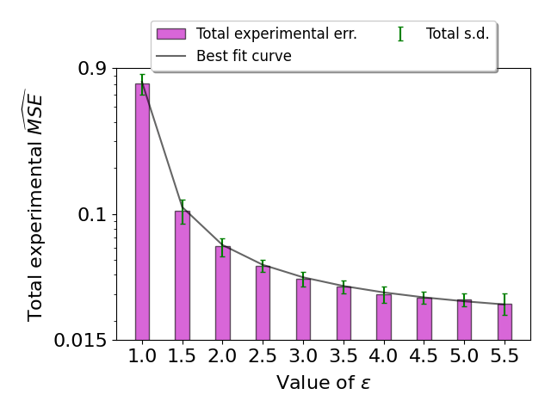
Fits closely to $ε^{−4/3}$ dependency from theory
Notes:
…large epsilon… \\

Slide 30
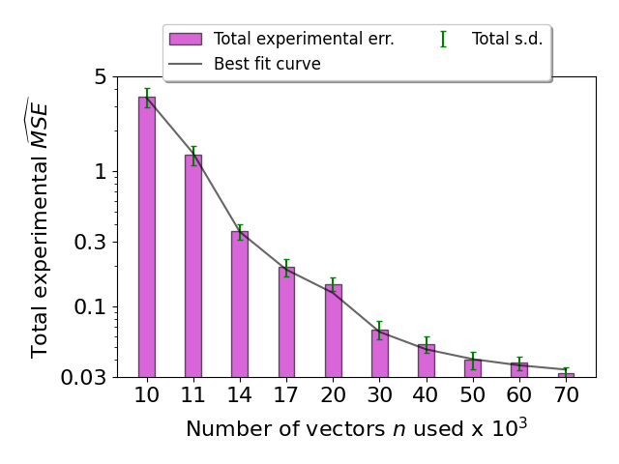
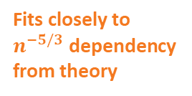
Fits closely to $n^{−5/3}$ dependency from theory
Notes:
…and the number of vectors n used. \\

Slide 31
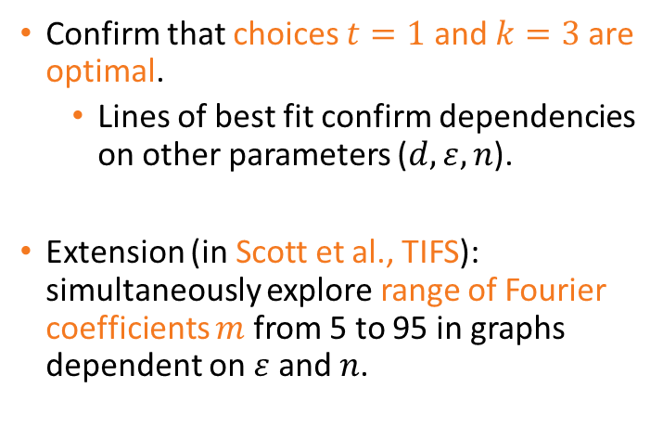
Experimental Evaluation
Confirm that choices $t=1$ and $k=3$ are optimal.
Lines of best fit confirm dependencies on other parameters ($d,ε,n$).
Extension (in Scott et al., TIFS): simultaneously explore range of Fourier coefficients $m$ from 5 to 95 in graphs dependent on $ε$ and $n$.
Notes:
\\ In conclusion we have confirmed that the choices t equals one and k equals three are optimal, with all other parameters satisfying their expected relationship with the normalized mean squared error. \\ We have also published a further paper in the I triple E Transactions on Information Forensics and Security which also explores our protocol in the Fourier domain. \\

Slide 32
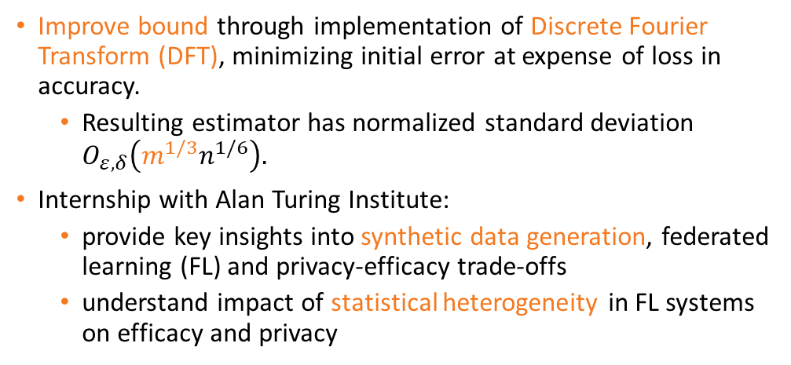
Scott et al., TIFS and Future Projects
Improve bound through implementation of Discrete Fourier Transform (DFT), minimizing initial error at expense of loss in accuracy.
Resulting estimator has normalized standard deviation $O_{ε,δ}\left(m^{1/3}n^{1/6}\right).$
Internship with Alan Turing Institute:
provide key insights into synthetic data generation, federated learning (FL) and privacy-efficacy trade-offs
understand impact of statistical heterogeneity in FL systems on efficacy and privacy
Notes:
\\ In more detail, our next work after this paper has improved the bound I have mentioned by implementing a Discrete Fourier Transform, with a normalized standard deviation dependent on the number of Fourier coefficients m to the one third, where m is much smaller than the vector dimension d. \\ Currently, I am working with the Alan Turing Institute to develop a protocol which can carry out federated analytics in a private way on synthetic data that can be statistically heterogeneous, or not, or any level in between. \\

Slide 33

Thank you for listening
Any questions?
Mary.P.Scott@warwick.ac.uk
Notes:
Thank you for listening to my presentation. Are there any questions?

